Slide 1

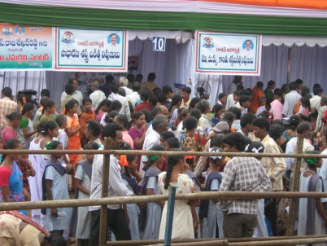
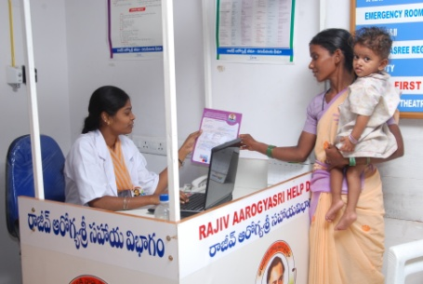
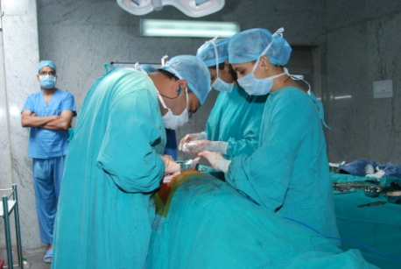
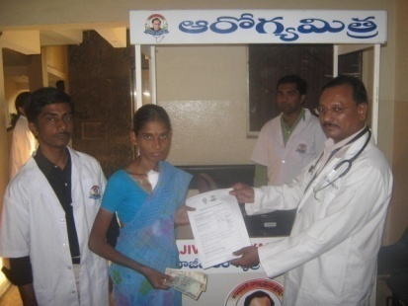
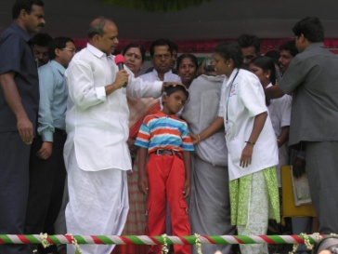
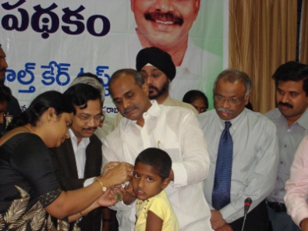
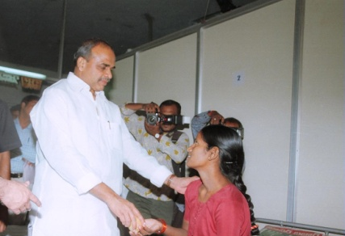
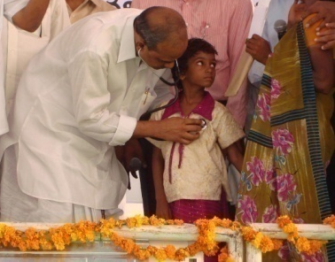
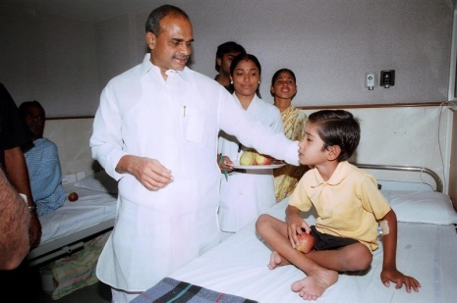
Rajiv Aarogyasri Health Insurance Scheme
Aarogyasri Health Care Trust

Slide 2


AGENDA
1
Scheme Background
2
Project Model
Implementation & Coverage
3
4
Project Stakeholders
5
Solution
6
Results

Slide 3
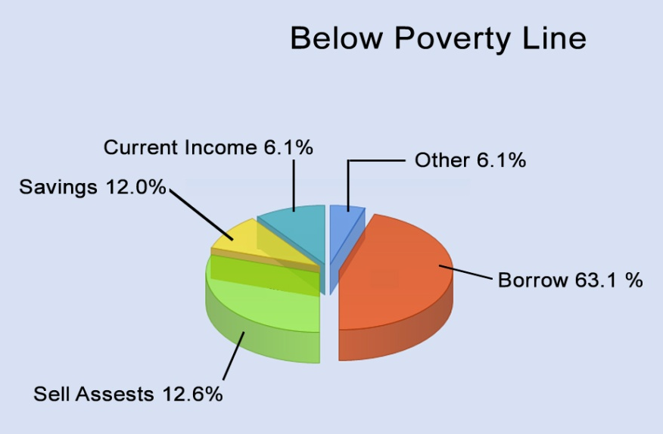
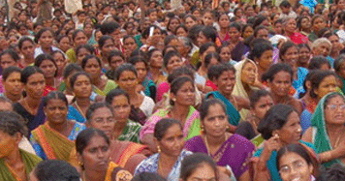
Scheme Back ground
Source: The Institute Of Health Systems, HACA Bhavan, Hyderabad, AP 500004
Escalating health care costs: leading to rural indebtedness
Large proportion of BPL families borrow money or sell assets to pay for hospitalization
No structured help for the poor
Institutional exploitation of the poor and illiterate
No proper guidance or awareness
Lack of health care infrastructure

Slide 4

Sequence of Steps
Non-effectiveness and complicated procedure involved in the CM relief fund help to BPL families
Aarogyasri Health Care Trust formation
Tailor made Insurance Scheme – PPP Model
Aarogyasri -I
Aarogyasri -II
Pilot in 3 Districts – Phase-1
Comprehensive ICT Solution
Entire state in phased manner

Slide 5
ORIGIN & EXPANSION OF AAROGYASRI
ORIGIN
CMRF (2004)
EXPANSION
DATE | DISTRICTS | PROCEDURES | SCHEME
01.04.2007 | 3 | 163 | Aarogyasri - I
05.12.2007 | 8 | 210 | Aarogyasri - I
05.04.2008 | 13 | 272 | Aarogyasri - I
17.07.2008 | 23 | 865 | Aarogyasri - I (Insurance) Aarogyasri - II (Trust) CMCO Referrals (Trust)
14.11.2008 | 23 | 942 | Aarogyasri - I (Insurance) Aarogyasri - II (Trust) CMCO Referrals (Trust)
CHILD CARDIAC
SURGERIES
(Aug, 2004)
AAROGYASRI – I
(April, 2007)
AAROGYASRI - II
(July, 2008)
CMCO (July, 2008)

Slide 6
Project Model - Public Private Partnership
GOVERNMENT
FUNDING
District Admin
Health care Trust
Insurance Company
Network hospitals
Quality Health Care For BPL Families
G2C
G2G
G2B
ICT Solution
Banks

Slide 7
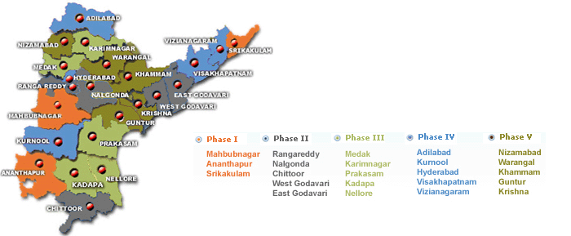
State wide Implementation
COVERAGE
All BPL Families – 2.03crore Family
Over 1100 Surgeries/Therapies
Over 400 Hospitals
Up to Rs. 2 Lakh Per Treatment

Slide 8
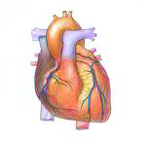



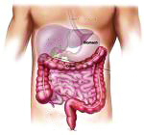
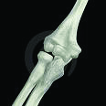
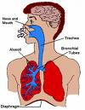



DISEASE COVERAGE
CRITERIA OF SELECTION
SURGICAL
(783 PROCEDURES)
MEDICAL
(159 PROCEDURES)
Emergency and Life saving in nature
Requiring Specialist Doctors & Special Equipment
Not ordinarily available in Govt. Hospitals (Area/CHC )
Verifiable Diagnostic and Post treatment Protocols
Not covered by other Government schemes
942 procedures in 31 systems
General Surgery
ENT
Ophthalmology
Gynecology & Obstetrics
Orthopedics
Surgical Gastroenterology
Cardio Thorasic surgery
Pediatric Surgery
Genito-Urinary surgery
Neuro-surgery
Surgical Oncology
Medical oncology
Radiation Oncology
Plastic Surgery
Polytrauma
Prostheses
Cochlear Implantation
Critical care
General Medicine
Infectious Diseases
Paediatric Intensive Care
Neonatal Intensive care
Paediatric General
Cardiology
Nephrology
Neurology
Pulmonology
Dermatalogy
Rheumatology
Endocrinology
Gastroenterology

Slide 9

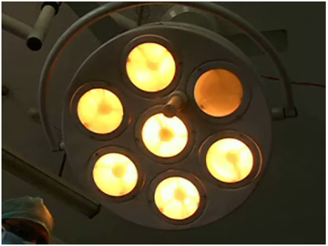
Cashless Treatment package
Each package covers the cost of the following:
Screening
Testing and Diagnosis
Medical treatment
Medicine
Transport
Food
Follow-up treatment
Packages are standardized in consultation with Medical experts

Slide 10
Project Stakeholders
Aarogyasri Trust EVC/CEO
Medical Camps
BPL Families
Trust administration
PHCs / Dist Hospitals
Self Help Groups
Insurance administration
ICT Solution
Aarogya
Mithras
District administration
Call Center
Banks
Field operations
Network hospitals
Field Operations

Slide 11
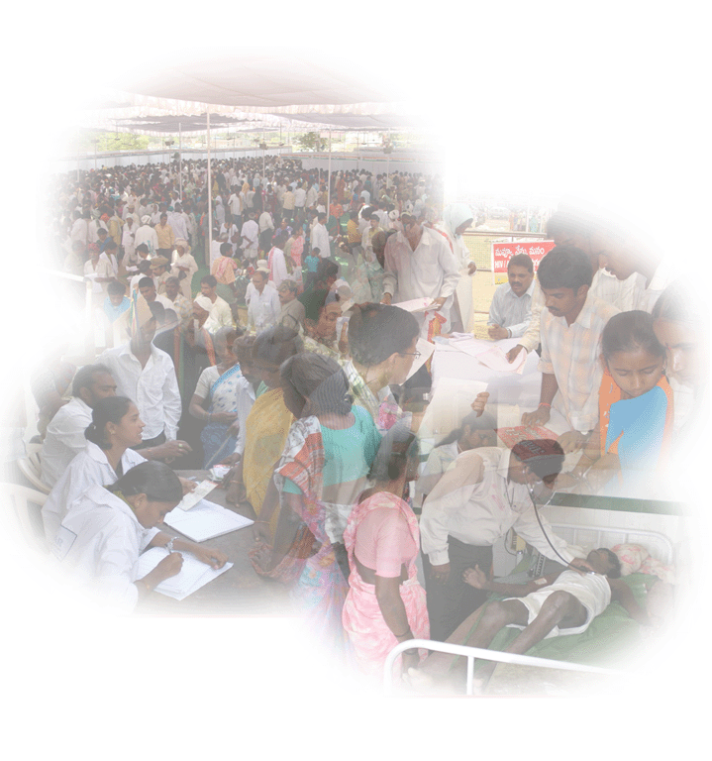
MAIN FEATURES
UNIVERSAL COVERAGE
All BPL Families 2.03 crores
CASHLESS TREATMENT
Up to Rs 2 lakhs in a year
HEALTH WORKERS
3057 Aarogyamithras
HEALTH CAMPS
12536camps so far
SIMPLE PROCEDURE
Health card/White Card
COST
Borne by the Government
DISEASES
Identified
PACKAGES
For end-to-end treatment
CHOICE OF HOSPITALS
Left to patients
MONITORED
On-line : 24 hour basis
IMPLEMENTATION
Aarogyasri – I : through Insurance Co. Aarogyasri – II : directly by Trust
CMCO : directly by Trust

Slide 12
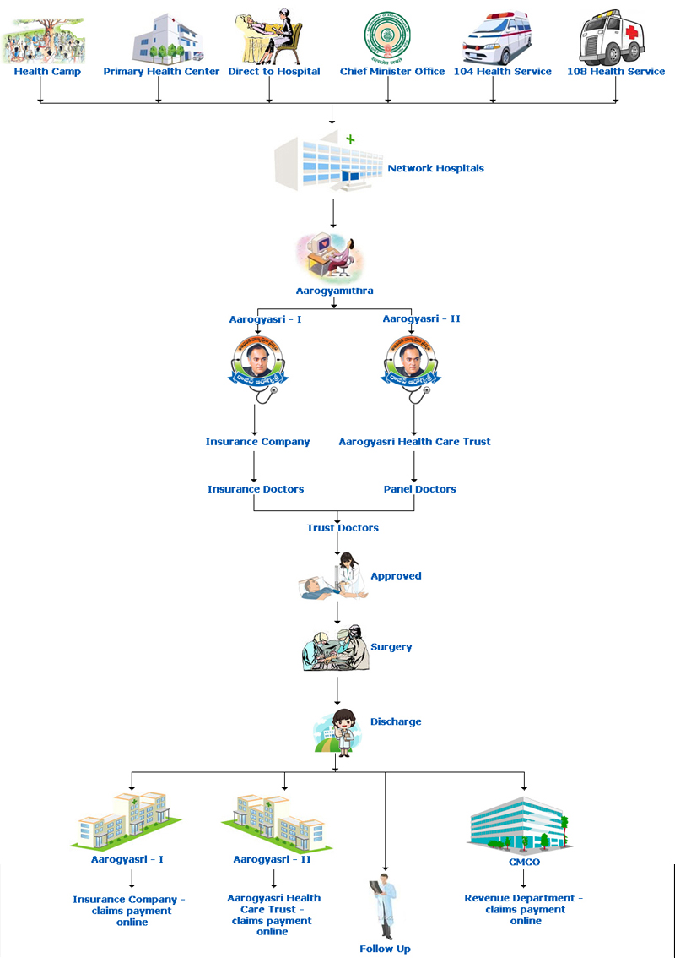
Process Flow

Slide 13
Infrastructure and Manpower
Aarogyamithras at PHC/CHC/Area Hospital | 1801
Aarogyamithras at Network Hospitals | 1199
Operations team (Preauth, Claims, Health Camps, Grievance etc.) | 356
Doctors (Preauth, Claims, Inspections etc.) | 175
Field officers | 224
Call Centre Executives | 126
Work Stations/Systems ( Computer, Servers) | 350
Total Bandwidth Usage | 68 mbps
Application Server ,Web server ,Data Base Server, File Server ,Back up server for Application server and Web server ,Back up server for data base server, Application server cluster ,Web server cluster | 1 each
TCS Professionals | 38
Notes:
13

Slide 14
COMPREHENSIVE SOLUTION
www.aarogyasri.org
BPL records
Hospital Empanelment
Medical Camps
Registrations
Pre Authorization
Case Inventory
Drug Distribution
Claims
Online Payments
Reports-MIS
Call Center
E Mail
Feedback
Accounts
Admin
Complex Application > Simple to Use > Quick & Quality service

Slide 15

Salient Features
Cashless treatment – BPL families
Aarogyamitras – Self Help Group
Life saving Diseases ~ 1200
Frequent workshops for the Users
Periodic Medical camps
SLA based Pre authorizations
Special wards in Network Hospitals
Revolving fund for Government hosp
Various Registration Channels
Grading of the hospitals
24*7 Call Center
Online Money transactions
Hospital Empanelment ~ 450
Patient Feedback
Complete ICT solution

Slide 16
HIGHLIGHTS OF THE SCHEME
Initiated as a pilot project.
Now grown in to a major programme
Started with 163 procedures in 6 systems;
942 procedures now covered in 31 human systems
All Trauma cases covered.
Coverage of BPL family increased from 1.80 crore to 2.03 crores.
Follow-up treatment for one year provided for 121 procedures.
Cochlear implantation for children up to 12 yrs age included

Slide 17
HIGHLIGHTS OF THE SCHEME
Network Hospitals increased from 36 to 343
850 Health camps every month screening 1.5 lakh people
1100 surgeries/ treatment daily costing Rs 3 Crores.
10,000 beds in Govt./Corporate Hospitals under occupation
4000 calls attended by call centre daily
3010 Aarogyamitras in Network hospital/ PHC for Patient care
3,71,172 surgeries/therapies done so far.

Slide 18
Solution highlights
Completely paperless
OVER 4000 EMPLOYEES
FOR
SUPPORT AND OPERATIONS
Monitor the program from anywhere
Round the clock availability of portal
All transactions available for Public Scrutiny
Complete Accountability & Transparency
BETTER MONITORING &
CONTROL MECHANSIM
THROUGH “ICT” SOLUTION
Cashless transactions
Online and Real time
Inventory of all medical records
Card verifications against Civil Supplies BPL data
CORRUPTION FREE
ENVIRONMENT
Internal communication between all Users - eMail
Online View/Update of bed capacity available in Hospitals
Online claims, payments and Control systems

Slide 19
Scheme without ICT
Fraud and Corruption at all stages -
Hospital Empanelment
Medical Camps
Registrations
Pre- Authorization
Claims and Billing etc
Difficulty in handling Huge money transactions non-transparent
Cannot achieve SLAs for pre-authorizations
Communication becomes non-effective
Less Accountability
Monitoring and controlling becomes a nightmare
Gain for Private Agencies
Service delivery is at stake
Victims – BPL Families
Government objective is at risk

Slide 20
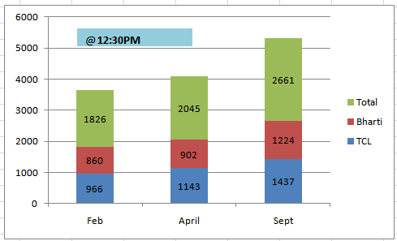
Concurrent Internet users at peak load
- 20 -
Notes:
20

Slide 21
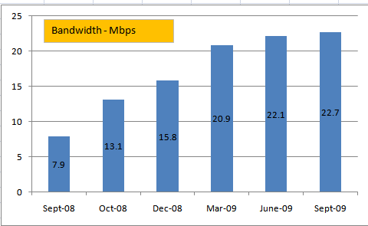
Internet bandwidth usage
- 21 -
Notes:
21

Slide 22
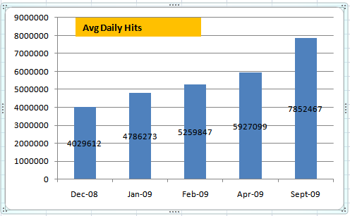
Daily Hits - Monthly
- 22 -
Notes:
22

Slide 23
Milestones – Surgeries
ICT solution costs hardly 1% of the total amount spent on the scheme so far - Approximately Rs 1.50 per beneficiary

Slide 24
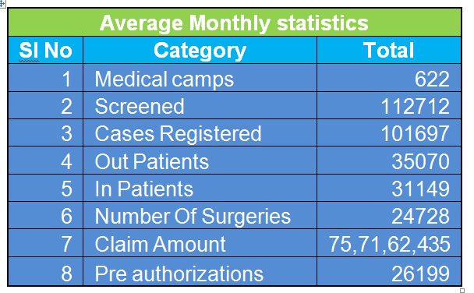
Monthly Statistics

Slide 25
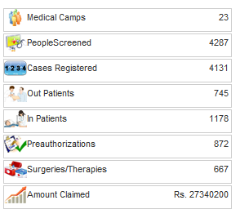
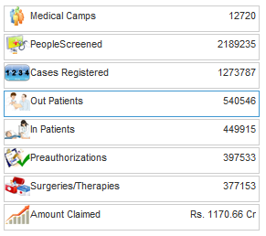
RESULTS
Live Data as on 17-09-2009, 12:30 AM
Last 24hrs Stats
Since April 1st 2007
Stake Holders
EFFECTIVE
SERVICE DELIVERY
ICT
Solution
Implementation
&
Coverage
44.21% of the patients treated are women, 11.36% are children and 67% are below 45 years of age.

Slide 26

RESULTS
SKOCH SUMMIT 2009 –
BEST SERVICE DELIVERY in INDIA

Slide 27
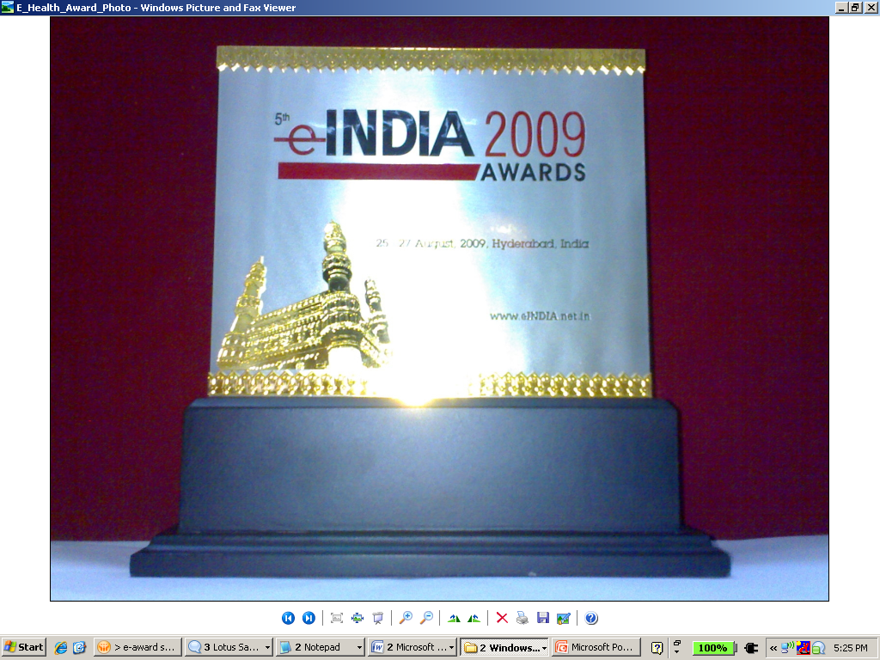
RESULTS
,
eINDIA 2009 – eHEALTH Awards
'Government Policy Initiative of the Year' through Public Opinion
Jury Award for 'Civil Society/Development Agency of the Year'..
“It is not an exaggeration to say that if IT stops, the entire Aarogyasri program stops. The program depends on IT every second. The (Late) Hon. Chief Minister used to say that we should use IT in every aspect of poor people life.“
-- Sri J.Satyanarayana, IAS, P.S., HM&FW

Slide 28
RESULTS
World health Forum - Geneva
Aarogyasri Health Care Trust received an invitation to showcase the scheme at the Forum for Health-Geneva 09 held on the sidelines of World Health Assembly by WHO in Geneva on May 20th, 2009. Chief Executive Officer of Trust was selected to be part of a group of luminaries to be panelists for the discussion on `Better use of IT and information health and healthcare’ organized during the event. Four countries viz., China, Egypt, Germany and UK held separate meeting with CEO for replicating good features of the scheme. The scheme was acclaimed as a superior low cost technology led intervention used for catering to the health needs of poor people
Recognition from Planning commission and Ministry of Health, Government of INDIA
Recently the scheme was showcased to the Planning Commission and Ministry of Health, Government of India. The scheme was acclaimed for its implementation and delivery mechanism. The scheme was also studied by National Institute of Public Finance and Policy.

Slide 29
RESULTS
Paper selected and Published in National 12th e-Governance Compendium
Studied and praised by World Bank and Harvard School
Many other states have initiated the implementation of the Scheme
Appraised by all scholars and political parties across the Country

Slide 30
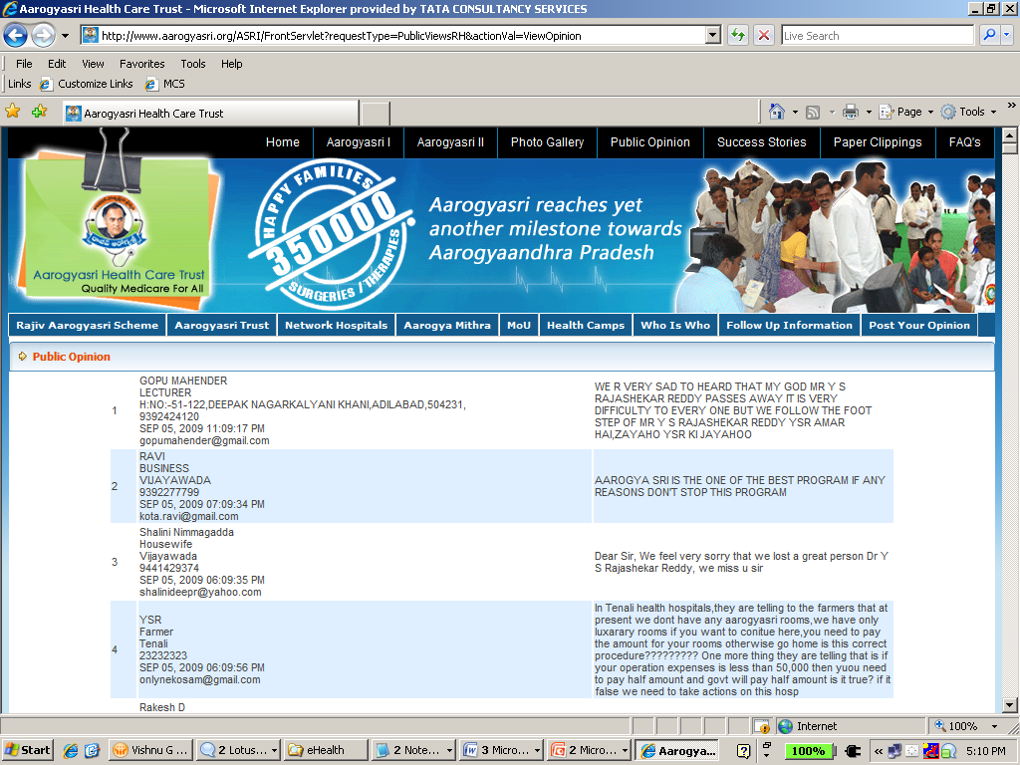
RESULTS
Public Opinion

Slide 31
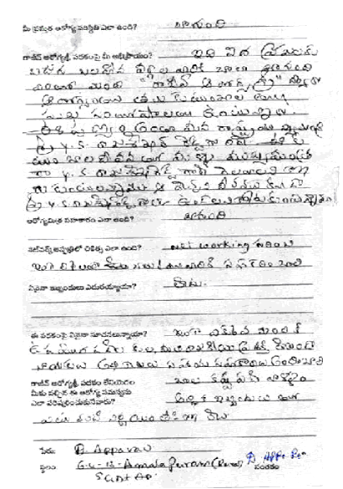
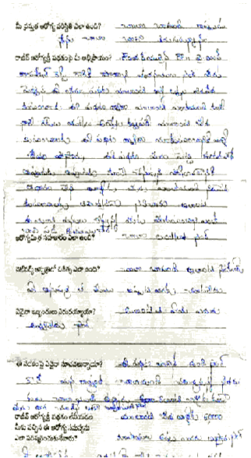
RESULTS
Letter
Feedback
from
patients

Slide 32
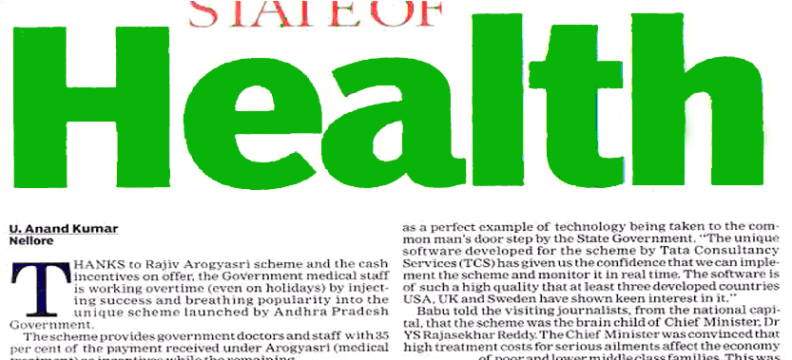
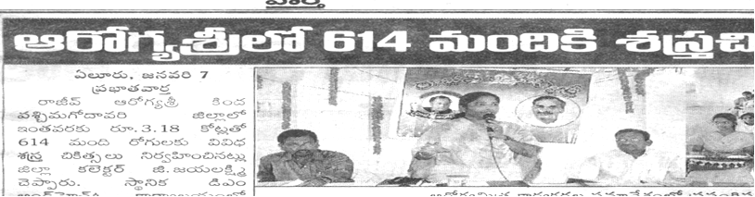
RESULTS

Slide 33

Thank You

